Slide 1
Botswana: Prosperity Undermined by Social discontent
Brittany Sheffield 17 April 2019
Notes:
Source: Wikipedia

Slide 2
Agenda
Democracy
Economy
Potential Pitfalls
Spending Initiative

Slide 3
Key Findings
Botswana is likely to remain stable for the next twelve to eighteen months:
Lack of political corruption
Free and open democracy
Growth of economy
Caveat: social unrest
Economic opportunities
Water disparity

Slide 4
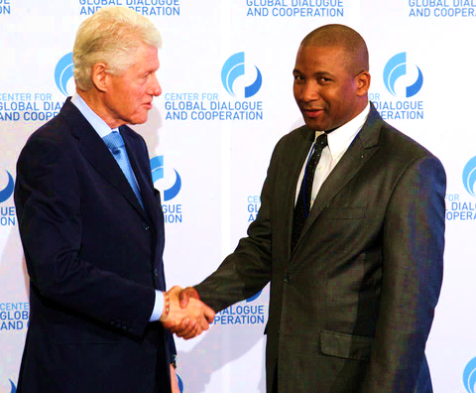
An Exemplar Democracy
Low corruption
Multiparty democracy
Botswana Democratic Party (BDP)
Umbrella for Democratic Change (UDC)
UDC success
Recent elections
Economic focused platform
Duma Boko Meeting Bill Clinton, 2012 | Zimbio
Notes:
http://www.zimbio.com/photos/Bill+Clinton/Duma+Boko/2nd+CGDC+Annual+Meeting+2012+Day+3/YOepzGHW8np

Slide 5
Economic Prosperity
Natural resources
Mining
Tourism
Reliance on environment
Populous centered around environment
Increased urban demand of water
Aquifers beyond sustainability
Botswanan Safari | Signature African Safaris
Notes:
https://www.signatureafricansafaris.com/botswana/

Slide 6
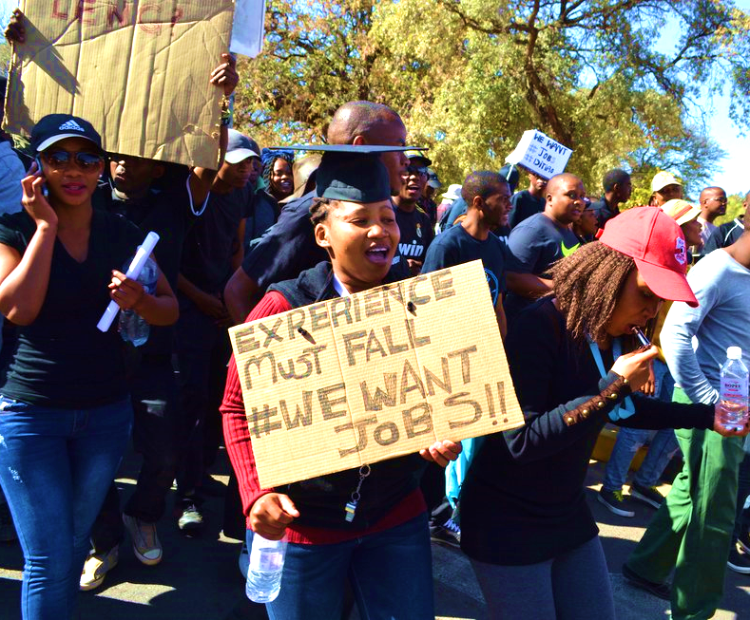
Potential Issues for Stability
Water disparity
Uneven distribution
Food shortages
Disrupts business, health, education
Unemployment
Youth demographic: 25 percent
Youth Protests in Botswana | Okay Africa
Notes:
https://www.okayafrica.com/botswana-unemploymentmovement-protest/

Slide 7
Spending Initiative
USD 100 million
Water resources
Allocation
Sanitation
Preservation
Impacts
Education
Employment

Slide 8
Thank you!
Questions? Brittany Sheffield sheffibn@dukes.jmu.edu

Slide 9
Spending Initiative Details
Ministry of Minerals, Energy and Water Resources (MMEWR)
Water accessibility
Ministry of Land Management, Water & Sanitation Services
Water management
Water infrastructure
Ministry of Investment, Trade and Industry (MITI)
Sustainable practice

Slide 10
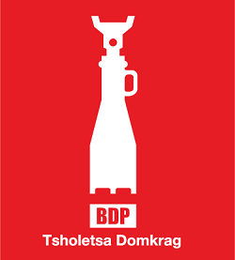
Botswana Democratic Party vs. the Umbrella for Democratic Change
BDP
UDC
Similar platforms, different execution
Inconsistent leadership mentalities
Incumbent
Similar platforms, different execution
Same leadership
Coalition opposition
Notes:
Source: Wikipedia

